Slide 1
Properties of Solvents and Solvent Classification
Three types of liquid substances, i.e. molecular liquids, ionic liquids and atomic liquids, can serve as solvents.
Molecular liquid solvents are the most common and include, besides water, many organic solvents and some inorganic solvents, such as
hydrogen fluoride,
liquid ammonia and
sulfur dioxide.
Ionic liquid solvents are mostly molten salts and usually used at relatively high temperatures.
Atomic liquid solvents at room temperatures, metallic mercury being a typical example.
tomic liquid solvents at room temperatures, metallic mercury being a typical example.

Slide 2
Molecular solvents other than water are generally called nonaqueous solvents.
For example, if a solute is dissolved in any solvent such as, benzene, alcohol, ether, carbon, disulphide, carbon tetrachloride, acetone, etc., the solution obtained is called a non aqueous solution.
Nonaqueous solvents are often mixed with water or some other nonaqueous solvents, to obtain desirable solvent properties. These mixtures of solvents are called mixed solvents.

Slide 3
Properties of Solvent
1. The temperature range over which it is a liquid.
2. Its dielectric constant
3. Its donor and acceptor properties
4. Its protonic acidity and bacisity
5. The nature and extent of autodissociation
6. Hydrogen bonding

Slide 4
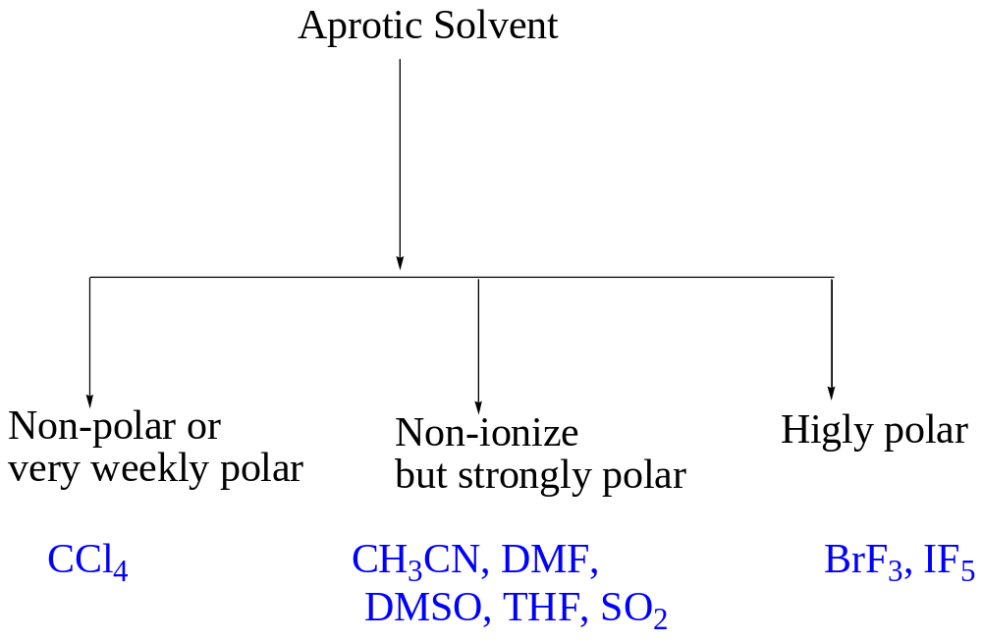
Types of Solvent
Protic Solvent : H₂O, HCl, HF, H₂SO₄
Aprotic Solvent :

Slide 5
Alkali Metals in Liquid Ammonia
Alkali metals (e.g., Na) in NH3(l) produce bronze colored solutions when
concentrated (> 1.0 M) and blue solutions when less concentrated.
• In both cases, the solution contains solvated electrons.
The more dilute blue solutions are strongly paramagnetic, becoming less so with
increasing concentration.
• In the concentrated solutions, extensive electron pairing occurs, making the
bronze colored solutions less paramagnetic.
• Solutions of metals in liquid ammonia are very strong reducing agents and react
very much like the free metals themselves.
• The reduction process appears to involve free solvated electrons.

Slide 6
Reduction of Ammonia by Alkali Metals
The resistance of ammonia itself to reduction provides a medium in which highly
reduced states are thermodynamically stable.
• Alkali metals do react very slowly with NH3 in a manner analogous to their behavior with water.
The reaction is catalyzed by small amounts of any Fe(III) salt.
• Catalytic mechanism is uncertain, but appears to involve rapid reduction of Fe(III)
to produce finely divided Fe(0), which may be the actual catalytic agent.

Slide 7

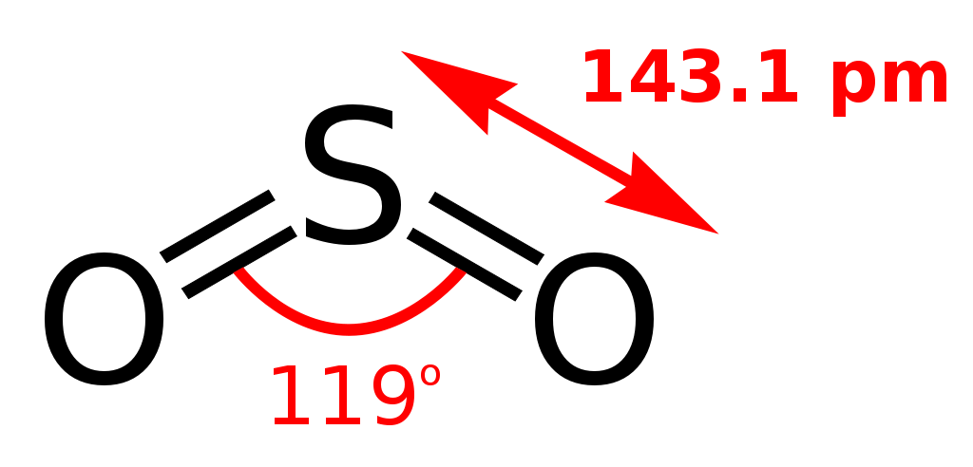

Slide 8
